Slide 1

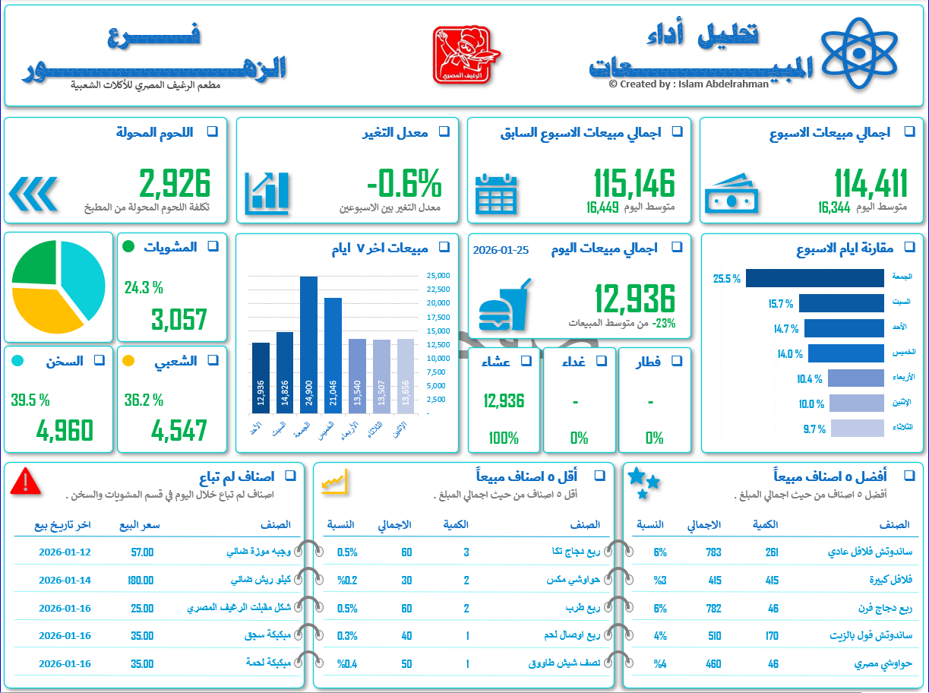
Sales Performance Dashboard

